Slide 1
Community-led models for improving care in prison: successes and challenges
Julia Sheehan
National Womens Criminal Justice Manager
The Hepatitis C Trust

Slide 2
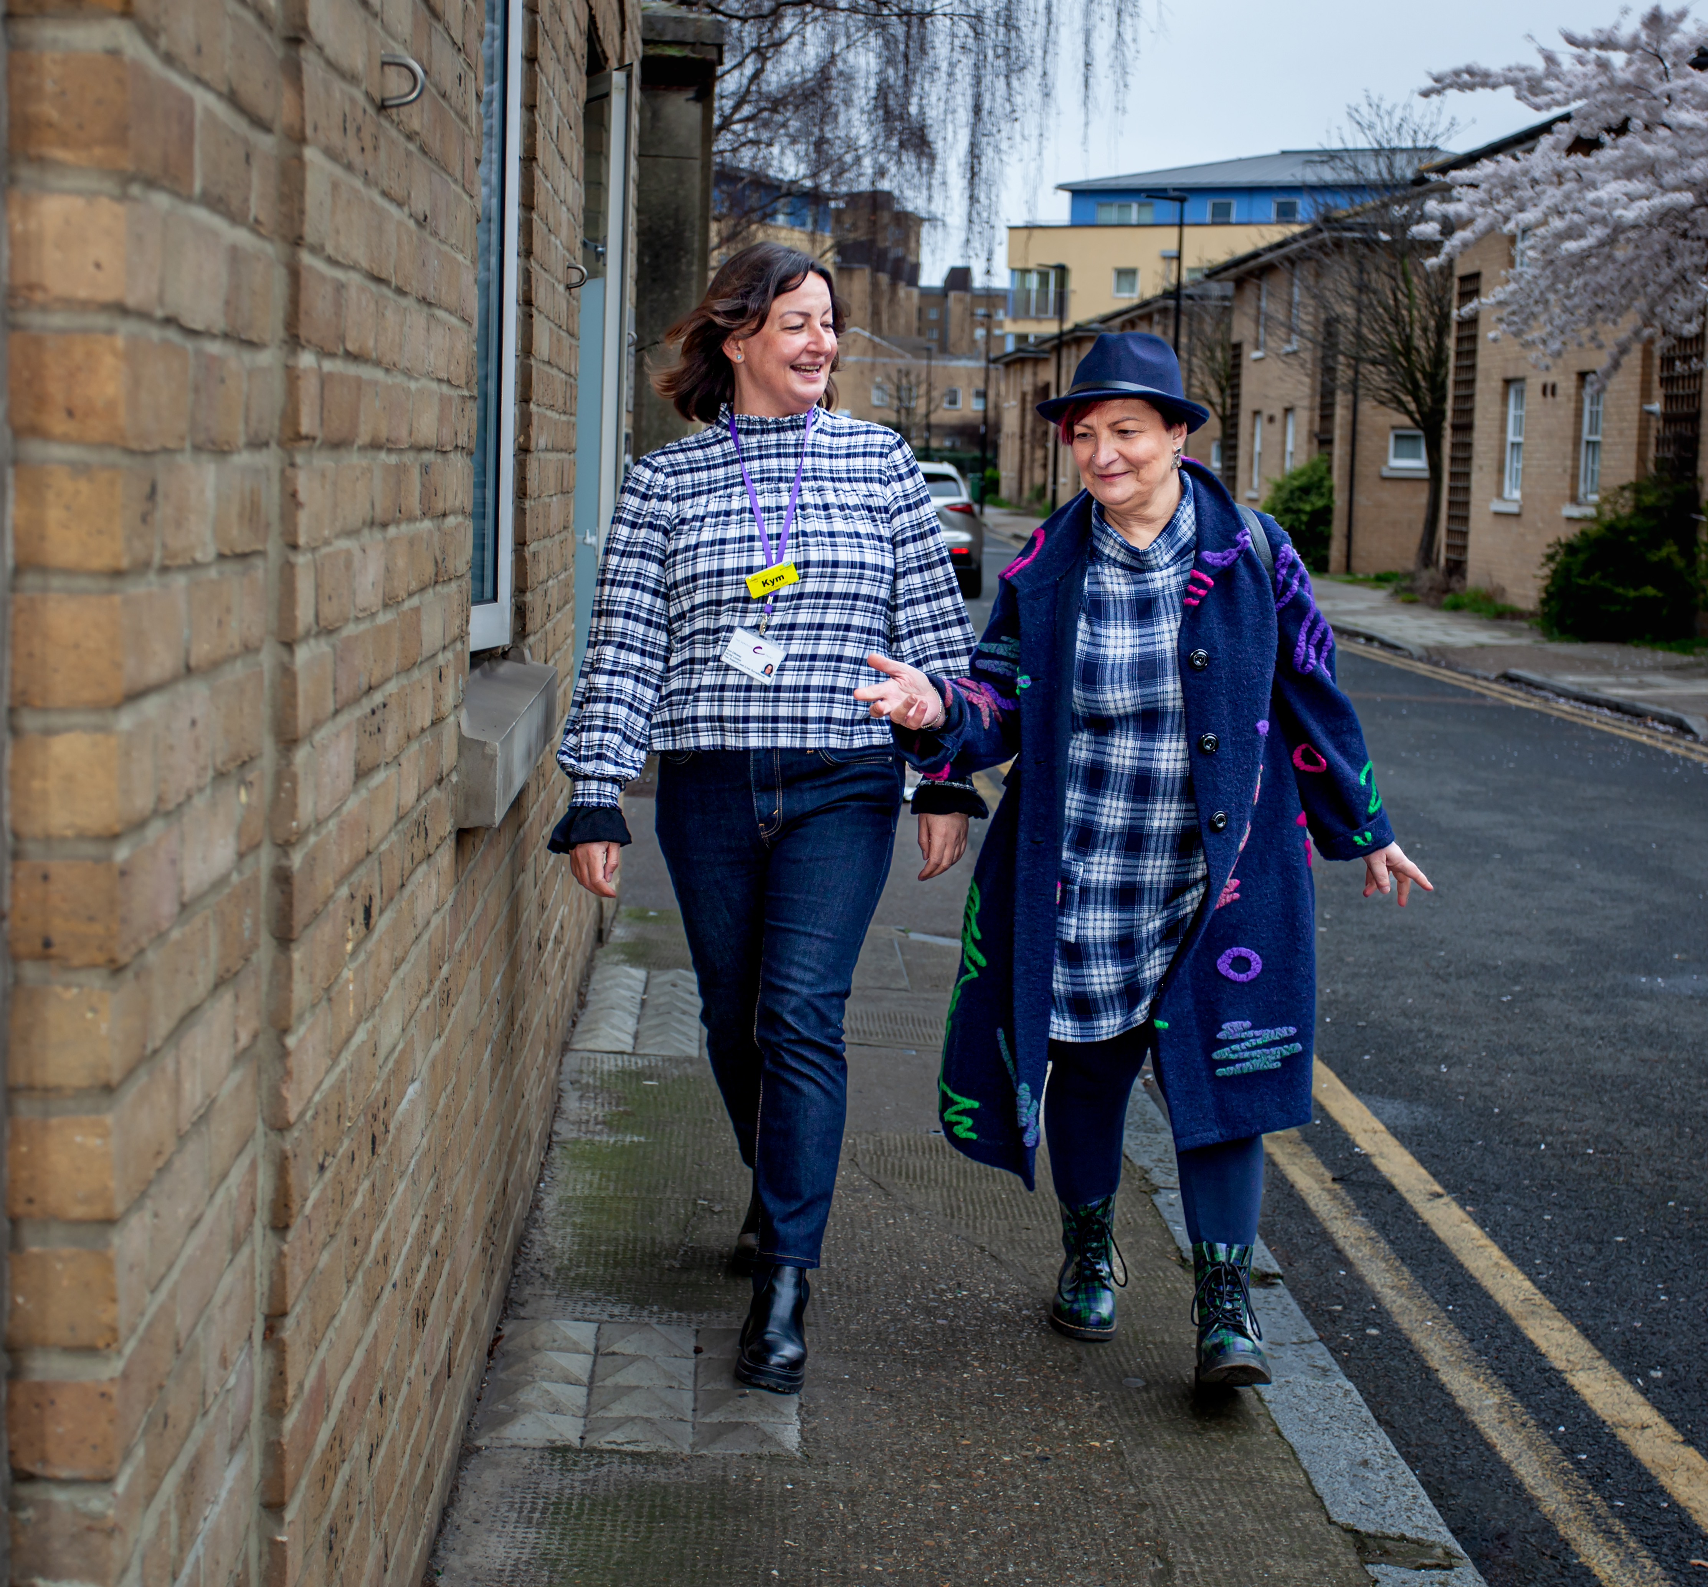
BACKGROUND INFORMATION
Established in 2000 – we are a peer-led and peer-run organisation which provides information, support and advocacy services for people affected by hepatitis C. ​
​
Over 95% of our staff have lived experience of hepatitis C, substance misuse and or criminal justice​
​
Community peer model was developed in 2010; and rolled out into prisons nationally in 2018
160 paid staff and over 300 volunteers working across local communities and the national prison estate – 130 staff deliver peer services​
​
Over the last 4 years we have tested 97,000 people and supported over 15,000 through treatment.

Slide 3
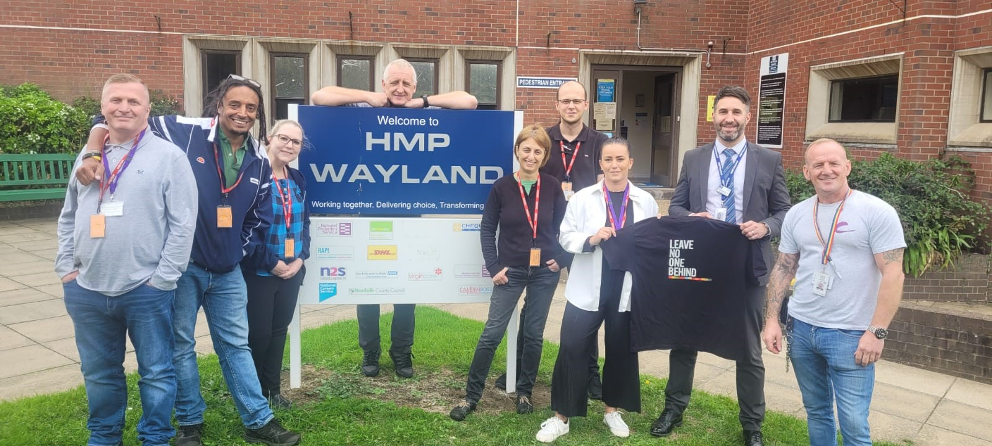
WHAT WE DO
Prison peer teams
Partnerships​
- Prison staff​
- Health Care​
- Substance misuse​
- Mental Health
Activities​
- Prison staff training​
- Promotional Materials ​
- Support clinics
- Education/P2P workshops​; raising awareness of hepatitis C, transmission routes, harm minimization​​
- HITTs
- Wing based outreach
31 paid staff + 186 volunteers

Slide 4
Prisons IN ENGLAND
102 Male prisons ( mixture of Reception, sentenced )
12 Female Prisons
5 Immigration Removal Centres
Male Population – 80,000
Female Population 3,300

Slide 5
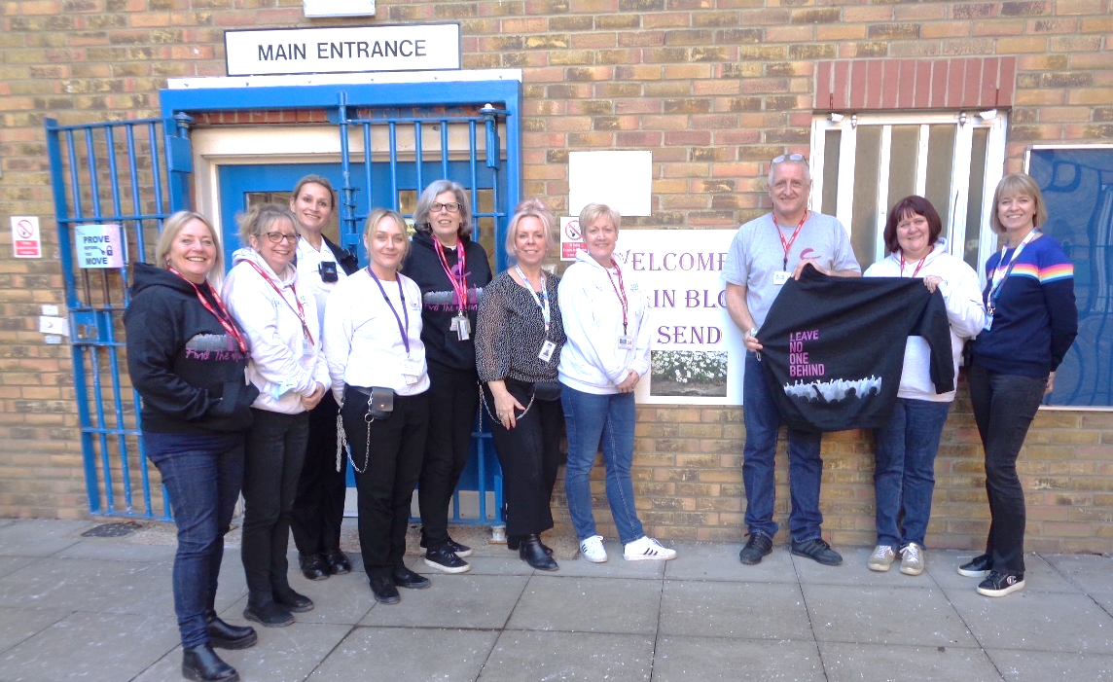
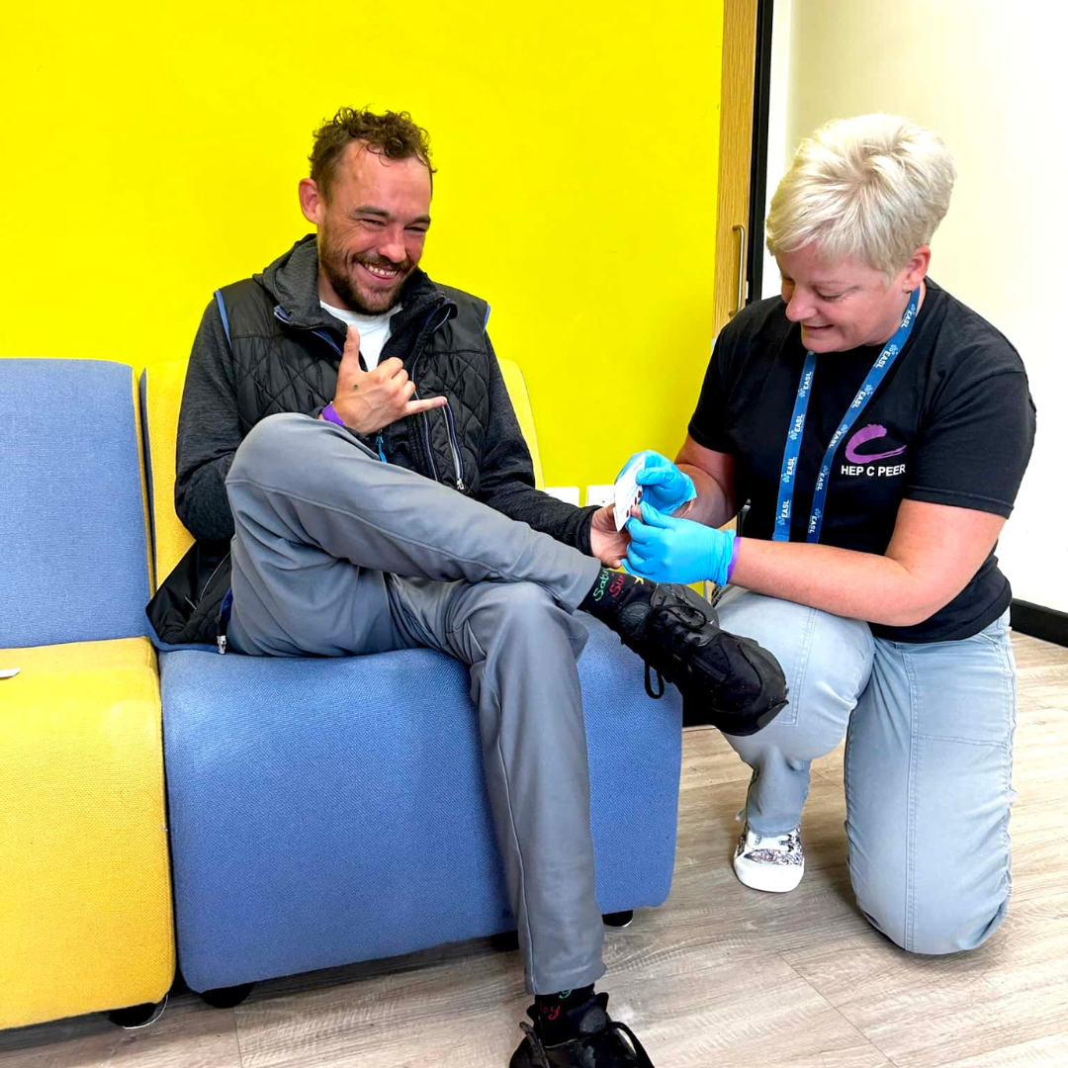
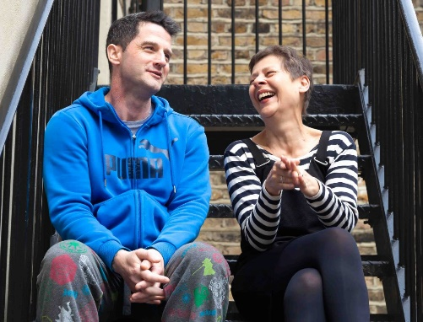
SUCCESSES AND CHALLENGES

Slide 6
PRISON PEER PROGRAMME 2018-23
HEPATITIS AWARENESS TRAINING
HAT/P2P TALKS DELIVERED TO PRISONERS
OUTREACH ENGAGEMENTS
NUMBERS TESTED
TREATMENT SUPPORT
WHOLE PRISON TESTING (HITTS)
1,208
64
14
6,166
10,355
130,438
43,539
STAFF
HITT EVENTS
MAINTAIN MICRO ELIMINATION

Slide 7
KEY MAGIC INGREDIENTS
Peer volunteers
Peers at every table – from strategic to operational delivery
Trained staff
Peers having access and holding Keys
Collaboration & Partnerships
National funding from the Department of Health
Buy-in from criminal justice

Slide 8
Challenges
Competing priorities
Prison vetting
Testing options (DBST, POCT, venous bloods)
Staff shortages
Prison regime
Stigma
Staff buy-in

Slide 9
PERSONAL EXPERIENCE

Slide 10
Take home messages
Prison healthcare services that are funded by the Department of Health and buy-in from Justice Services; importantly the prison Governor
Continuity of care from prison to community
Maximise the opportunity to address health needs while in prison
Now is the time to focus on people serving sentences in the community; probation
PEERS

Slide 11
Thank you!

