Slide 1
INHSU 2023 Genève
Models of care

Slide 2
What vehicle?
Backpacks
Bicycles
Buses

Slide 5
What box?
Adaptive + flexible
Integrated
AOD
Mental health
Cancer services
Collaborative
Multidisciplinary / interdisciplanary
Nurse led – NP program
Pharmacists on board
Social workers
Innovative
Phones
Hotel vouchers
Seek and treat
Feet on the street
After hours outreach
Ziege
Notes:
Telehealth support from peers in Oregon

Slide 6
Peer-Facilitated Telemedicine Hepatitis C Treatment for Rural People Who Use Drugs​
Results from a Randomized Controlled Trial​
TeleHCV Component 1: Peer Support
Pre-treatment support:​
Rapid HCV/HIV testing​
Harm reduction services​
Insurance enrollment​
Pre-treatment eval lab support
Andy Seaman, MD​
Associate Professor, ​
Department of Medicine / Addiction Medicine​
Oregon Health & Science University ​
​
Medical Director HCV/HIV Services, ​
Central City Concern
TeleHCV Treatment Arm: ​
Telemedicine visit facilitation, including bringing technology to participant​
Medication pick-up, adherence support, surveys, and retention​
Medication lockers if unstably housed​
Crisis management​
Housing assistance during HCV treatment​
Enhanced Usual Care Arm: ​
Warm handoff to additional peer support and insurance hep C navigators​
Provide referral information for local HCV treatment providers​
Surveys and retention​

Slide 7
Which test?
Use the suite!!!
Dried blood spot
Point of Care
HCV
HBV
HIV
Syphilis
Venepuncture
Capillary collection
Self collection

Slide 8
Who’s input?
Peer informed
NON-Discriminatory
Ask the questions
“Listen to the whispers”
Ask for clarification
Involve in solutions & Implementation
Ask if it works
Adapt
Ask if it still works
‘Know when to shout’

Slide 9
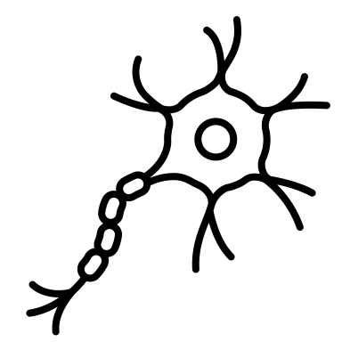
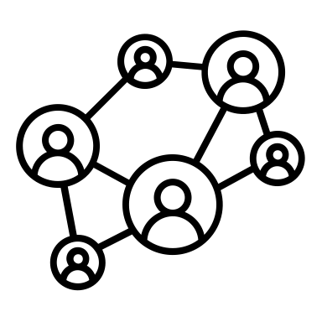
Determinants of health
What framework?
Social and economic environment
Physical environment
Persons individual characteristics and behaviors
Income $$
Social status
Education
Communities
Safe water
Clean air
Safe housing
Transport
Health services
Social networks
Culture
Genetics
Gender

Slide 10
Public health vs comprehensive care
High intensity testing activities
++ effort to find people
Treatment as prevention
Wrap around services
Person centered
Comprehensive health assessment prior to treatment
Gateway into health services
Follow up – primary care referrals
Identifies other health needs
Person centered

Slide 11
Get out – Get down – Get real

Slide 12
