Slide 1



Global best practice examples of prison-based models of care
Joaquin Cabezas

Slide 2
Global best practice examples of prison-based models of care
Good
Joaquin Cabezas

Slide 3
Disclosures
Lectures: Gilead, Abbvie.
Advisory boards: Gilead, Abbvie.
Grants: Gilead, Abbvie.

Slide 4

Agenda
Models of care for Hepatitis C [in prison]
  Why?
  How?
In Prison: the oportunity!
Best Practices examples
Conclusion

Slide 5
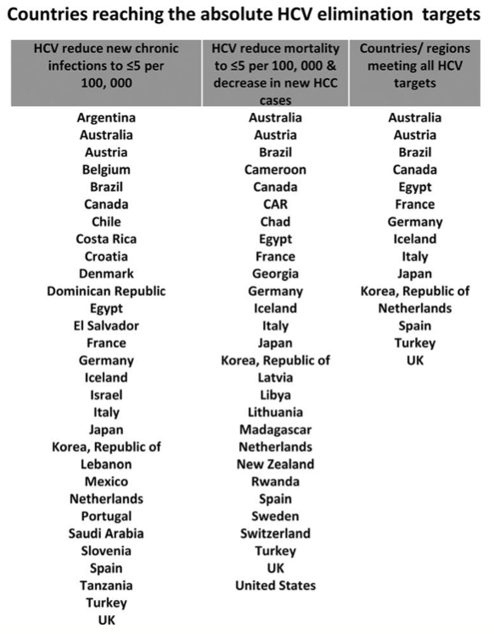



Why? - ELIMINATION
Annual Incidence: <5/100,000
Annual Mortality: <2/100,000
The recommended targets by Polaris Observatory Collaborators are:
HCV new chronic cases ≤5 per 100,000,
HCV mortality ≤5 per 100,000, and
demonstrate HCV year-to-year decrease in new HCV-related HCC cases.
https://www.who.int/publications/i/item/9789240028395
Polaris Observatory Collaborators. Journal of viral hepatitis. 2021;28(1):12-9. Kondili LA, Craxi A, Aghemo A. Liver Int. 2021;41(4):649-55

Slide 6
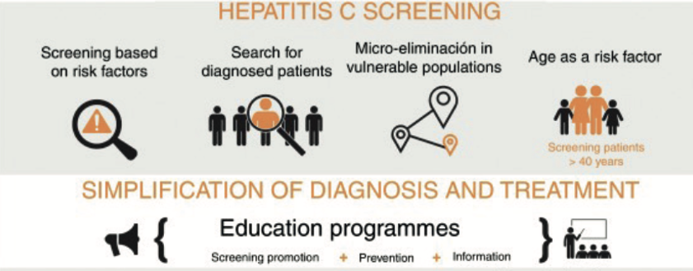

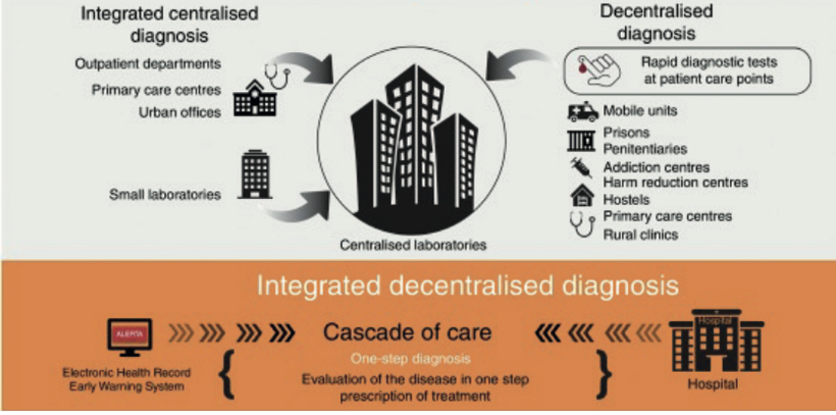
How?
Hepatitis C management:
Crespo J, et al. Rev Esp Enferm Dig. 2019; 111(11): 862-73. / Gastroenterol Hepatol 2019
Winter RJ, et al. Med J Aust. 2023;218(5):231-7.
Notes:
In fewer than 10 years, HCV care has moved from a complicated to a far simpler paradigm for providers and patients...
Guia de prisiones Australia
Winter RJ, et al. Med J Aust. 2023;218(5):231-7.

Slide 7

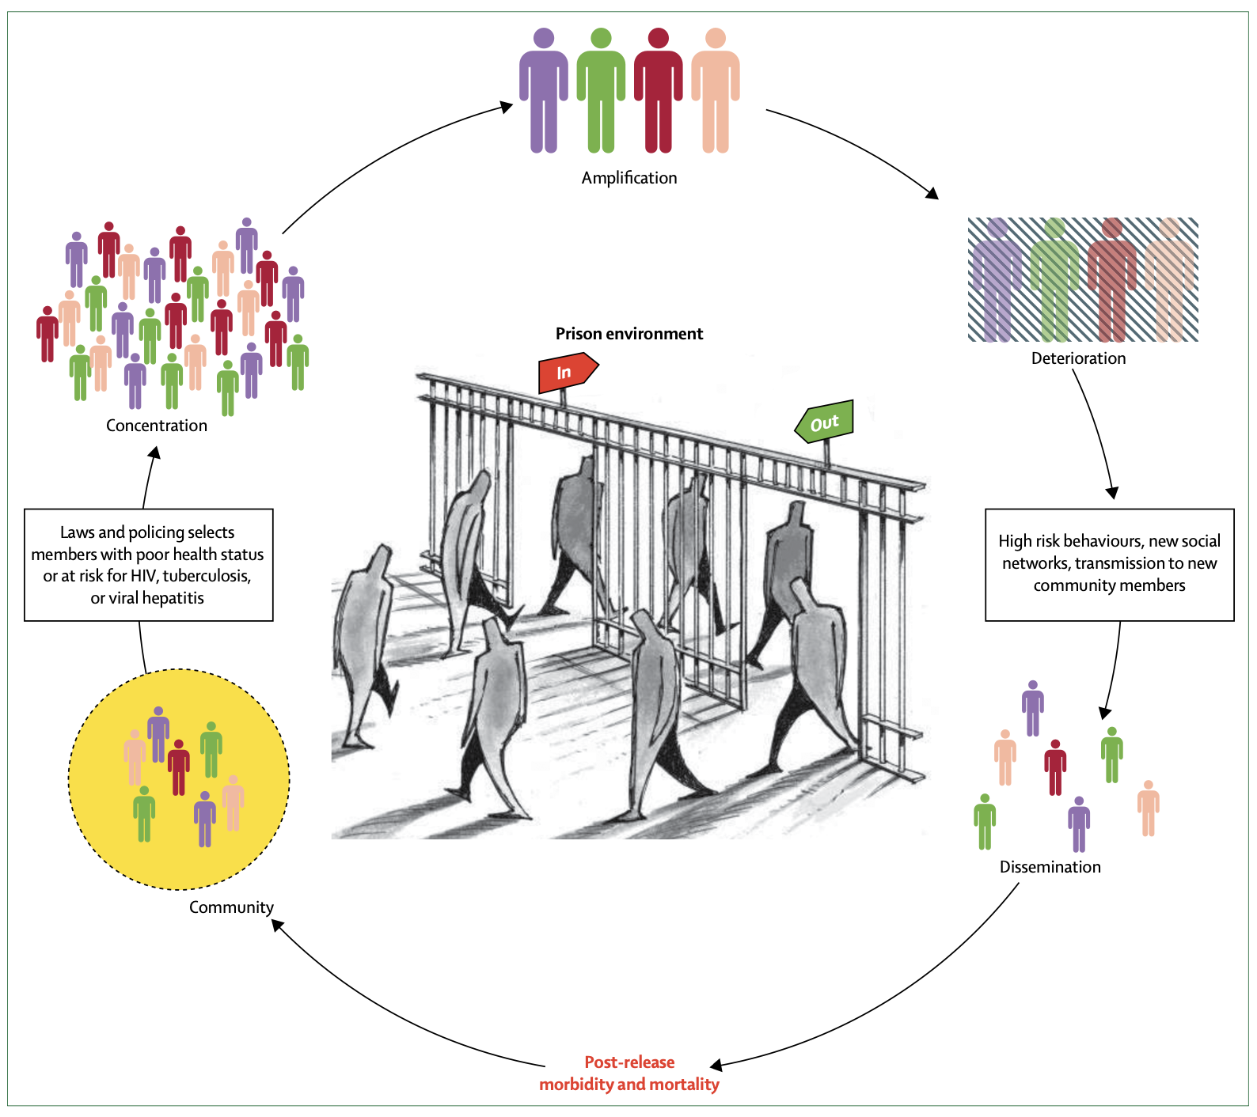

Prison as an OPPORTUNITY for HEALTH CARE
Features of the prison setting:
  Unique physical structure.
  Predominantly short stay/Frequent movements.
  High rates of addiction and mental health disorders.
Prisons provide an opportunity
to engage marginalised individuals into healthcare
Curing people of HCV in prison may positively impact HCV epidemiology
in the prison and wider community
Crespo J, et al Cur Hepat Reports. 2019;18(2):259-67. de Viggiani N. Sociology of Health & Illness 2007;29:115-35 Crespo J, et al. Rev Esp. de San Penit. 2017;19(3):70-3. Akiyama MJ, et al. Lancet Gastro Hepatol. 2021;6(5):391-400 Kamarulzaman A, et al. Lancet. 2016;388(10049):1115-26.
Notes:
Akiyama MJ, Kronfli N, Cabezas J, Sheehan Y, Thurairajah PH, Lines R, et al. Hepatitis C elimination among people incarcerated in prisons: challenges and recommendations for action within a health systems framework. Lancet Gastroenterol Hepatol. 2021;6(5):391-400.
Crespo J, Llerena S, Cobo C, Cabezas J. Is HCV elimination possible in prison? Revista espanola de sanidad penitenciaria. 2017;19(3):70-3.
Ref de Andrew: de Viggiani N. Unhealthy prisons: exploring structural determinants of prison health. Sociology of Health & Illness 2007;29:115-35
Crespo J, et al Current Hepatology Reports. 2019;18(2):259-67. doi: 10.1007/s11901-019-00472-2
de Viggiani N. Sociology of Health & Illness 2007;29:115-35
Crespo J, et al. Rev Esp. de sanidad penitenciaria. 2017;19(3):70-3.
Akiyama MJ, et al. Lancet Gastroenterol Hepatol. 2021;6(5):391-400.
Kamarulzaman A, Reid SE, Schwitters A, Wiessing L, El-Bassel N, Dolan K, et al. Prevention of transmission of HIV, hepatitis B virus, hepatitis C virus, and tuberculosis in prisoners. Lancet. 2016;388(10049):1115-26.
Kamarulzaman A, et al. Lancet. 2016;388(10049):1115-26.

Slide 8
The OPPORTUNITY starts with political will
Regional or National Plans
WHO. Access to hepatitis C testing and treatment for people who use drugs and people in prisons – a global perspective. 2019.
Available at: https://www.who.int/hepatitis/publications/idu-prison-access-hepatitis-c/en/. Accessed September 2019.

Slide 9


Including the penitentiary setting in National Plan
Recommendations include:²
Implement harm reduction/prevention measures in prisons.
Develop policies and procedures to improve access to HCV prevention, testing and treatment in prisons.
Provide HCV treatment for all HCV infected prisoners
Include prison environments in HCV research.
Provide rapid linkage to services upon release.
Recommendations include:¹
Improved harm reduction/prevention measures in prisons.
Research into increasing prevention, testing and treatment in prisons.
Nurse-led models of care in prisons.
Recognises people
in custodial settings as a key population
Recognises people with experience in
the prison system as
a priority population
1. https://www.health.gov.au/sites/default/files/documents/2022/06/fifth-national-hepatitis-c-strategy-2018-2022.pdf
2. https://www.canhepc.ca/sites/default/files/media/documents/blueprint_hcv_2019_05.pdf

Slide 10


Including the penitentiary setting in National Plan
The Spanish national plan included people in prison as a priority population
Penitentiary institutions were key collaborators in implementing the plan and evaluating key indicators of progress.
The focus for people in prison was on prevention and diagnosis
  Harm-reduction provision
  Screening and diagnosis programmes
Strategic plan for addressing hepatitis C in the national health system. 2015. Available at:
http://www.mscbs.gob.es/ciudadanos/enfLesiones/enfTransmisibles/docs/plan_estrategico_hepatitis_C.pdf

Slide 11
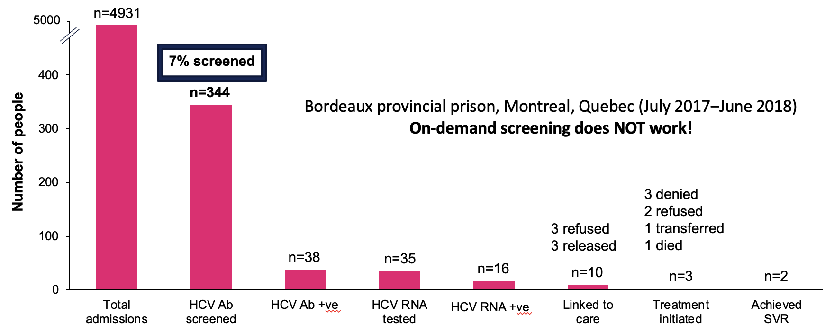
A must know: screening
Kronfli N, et al. CMAJ Open. 2019;7(4):E674-E9
Notes:
Kronfli N, Dussault C, Klein MB, Lebouche B, Sebastiani G, Cox J. The hepatitis C virus cascade of care in a Quebec provincial prison: a retrospective cohort study. CMAJ Open. 2019;7(4):E674-E9.
Kronfli N, et al. CMAJ Open. 2019;7(4):E674-E9.

Slide 12
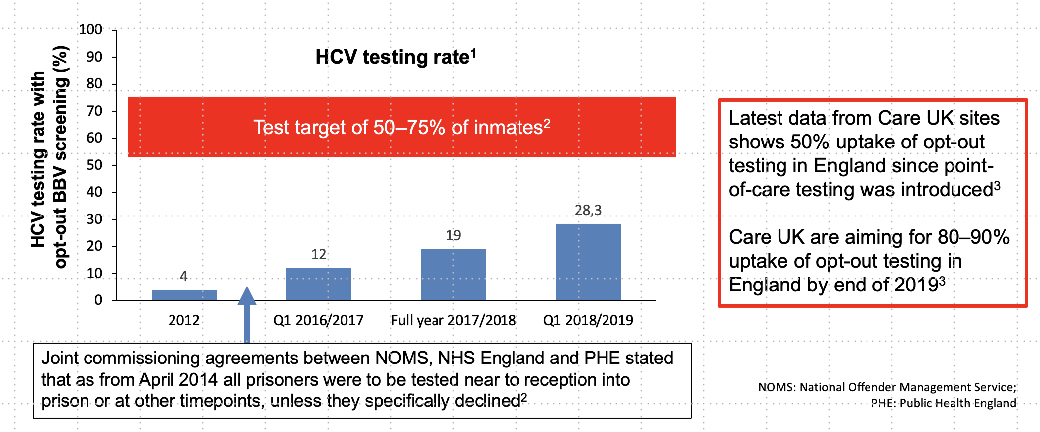
A must know: screening
Opt-out – Universal screening
1. http://www.hcvaction.org.uk/sites/default/files/resources/Hep%20C%20Coalition%20HCV%20and%20BBVs%20in%20Prison.pdf 2. Jack K, et al. J Viral Hepat 2019;26:644–54; 3.Francis G, unpublished data from Care UK

Slide 13


A must know: treatment
DAA – direct acting antivirals, provide high cure rates (>95% of SVR – Sustaind Sirological Response).
Tablets – oral, dayly intake for 8-12 weeks
Safe.
Issues:
Need specialist prescription
Hospital Farmacy delivery

Slide 14














Models of care in prison for HCV elimination

Slide 15
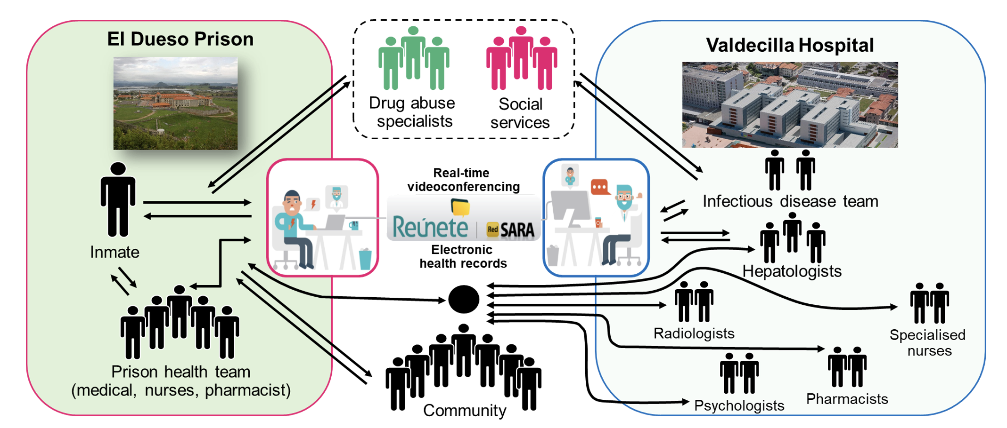

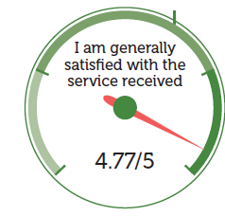
JailFree-C
N=851
Anti-HCV+ (n=110)
Seroprevalence 13.0%
HCV RNA+ (n=86)
Viraemia prevalence: 10.2%
99.5% screened for HCV (847/851)
80%% treatment rate (69/86)
A health care model includes:
Education programs.
Universal screening of infection
Simplified strategies to HCV diagnosis
Universal and immediate linkage to care
A multidisciplinary care team
Telemedicine
Harm Reduction Programs
€578 saved
per person with telemedicine
High level of patient satisfaction (N=200)
Cuadrado A, et al. Am J Gastroenterol. 2018;113(11):1639-48.
Cuadrado A, et al. Int J Drug Policy. 2020;88:103031. 4
Notes:
Cuadrado A, et al. Am J Gastroenterol. 2018;113(11):1639-48.

Slide 16
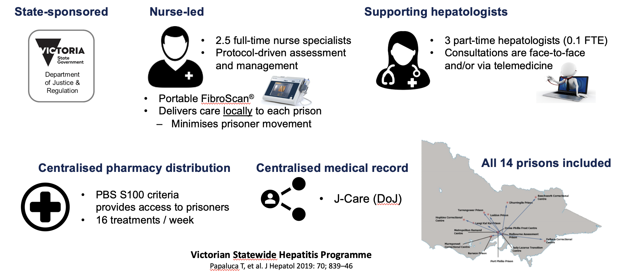
Nurse-led, statewide model of care
Opt-in screening
SVR12 rate was 96% (301/313) per protocol
Papaluca T et al. J Hepatology 2019: 70; 829-46

Slide 17
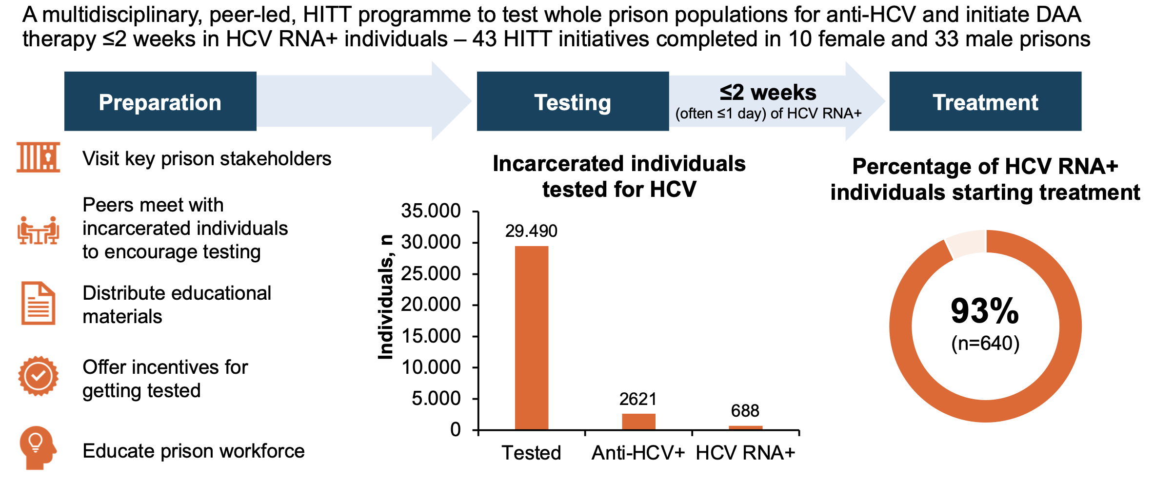
HITT programme in English prisons: test-and-treat is possible
Peer-led screening, with point-of-care antibodies - screening rate: 80%
HITT: high-intensity test-and-treat
Emmanouil B, et al. EASL 2022; Oral OS053; EASL. J Hepatol 2022;77:S44–5
Notes:
Emmanouil B, et al. EASL 2022; Oral OS053; EASL. J Hepatol 2022;77:S44–5

Slide 18
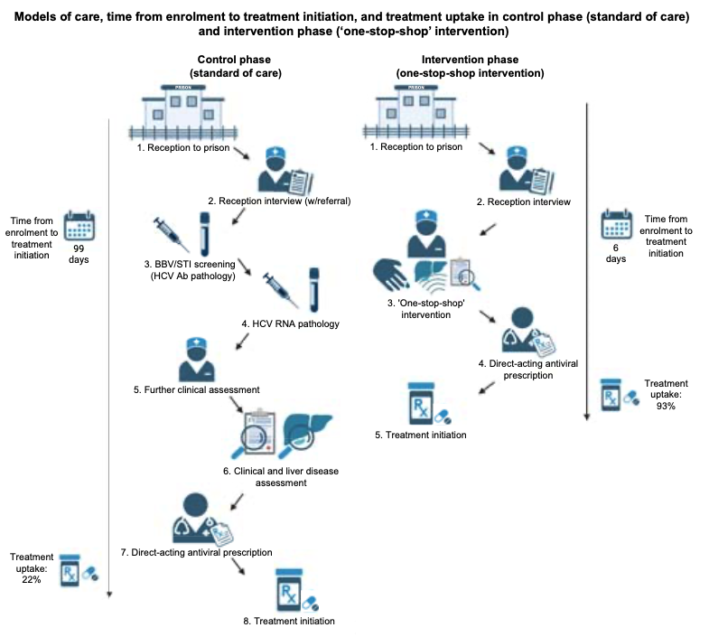
One-stop-shop (PIVOT Study)
Point-of-care HCV RNA,
Fibro-elastography,
Nurse-led clinical assessment, and
Fast-tracked DAA prescription within a single visit
HCV testing: 26%
HCV testing: 99%
Sheehan Y, et al. J Hepatol. 2023. doi: 10.1016/j.jhep.2023.04.019. PubMed PMID: 37116714.
Notes:
Sheehan Y, Cunningham EB, Cochrane A, Byrne M, Brown T, McGrath C, Lafferty L, Tedla N, Dore GJ, Lloyd AR, Grebely J. A 'one-stop-shop' point-of-care hepatitis C RNA testing intervention to enhance treatment uptake in a reception prison: the PIVOT study. J Hepatol. 2023. Epub 2023/04/29. doi: 10.1016/j.jhep.2023.04.019. PubMed PMID: 37116714.
Sheehan Y, et al. J Hepatol. 2023. doi: 10.1016/j.jhep.2023.04.019. PubMed PMID: 37116714.
https://www.natap.org/2023/HCV/092423_03.htm#:~:text=Many%20clinicians%20call%20this%20a,treatment%20uptake%20(93%25%20vs.

Slide 19
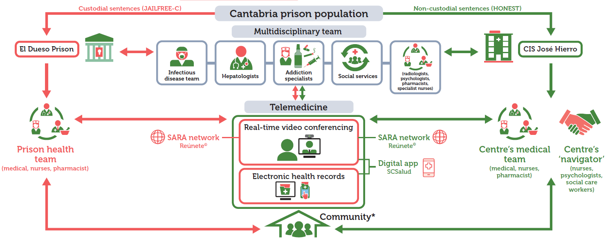
The HONEST project
Non-custodial sentences:
Cabezas J, et al. Diagnostics (Basel). 2021;11(5). doi: 10.3390/diagnostics11050877. PubMed PMID: 34068955; PMCID: PMC8155928.
Notes:
Cabezas J, Llerena S, Mateo M, Alvarez R, Cobo C, Gonzalez V, Martro E, Cuadrado A, Crespo J. Hepatitis C Micro-Elimination beyond Prison Walls: Navigator-Assisted Test-and-Treat Strategy for Subjects Serving Non-Custodial Sentences. Diagnostics (Basel). 2021;11(5). Epub 2021/06/03. doi: 10.3390/diagnostics11050877. PubMed PMID: 34068955; PMCID: PMC8155928.
Cabezas J, et al. Diagnostics (Basel). 2021;11(5). doi: 10.3390/diagnostics11050877. PubMed PMID: 34068955; PMCID: PMC8155928.

Slide 20
The HONEST project
Non-custodial sentences:
Cabezas J, et al. Diagnostics (Basel). 2021;11(5). doi: 10.3390/diagnostics11050877. PubMed PMID: 34068955; PMCID: PMC8155928.
Notes:
Cabezas J, Llerena S, Mateo M, Alvarez R, Cobo C, Gonzalez V, Martro E, Cuadrado A, Crespo J. Hepatitis C Micro-Elimination beyond Prison Walls: Navigator-Assisted Test-and-Treat Strategy for Subjects Serving Non-Custodial Sentences. Diagnostics (Basel). 2021;11(5). Epub 2021/06/03. doi: 10.3390/diagnostics11050877. PubMed PMID: 34068955; PMCID: PMC8155928.
Cabezas J, et al. Diagnostics (Basel). 2021;11(5). doi: 10.3390/diagnostics11050877. PubMed PMID: 34068955; PMCID: PMC8155928.

Slide 21
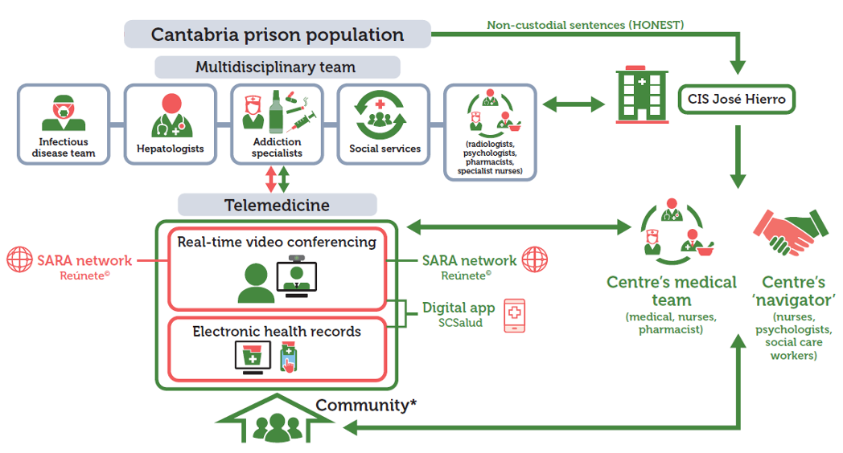
The HONEST project
Non-custodial sentences:
Cabezas J, et al. Diagnostics (Basel). 2021;11(5). doi: 10.3390/diagnostics11050877. PubMed PMID: 34068955; PMCID: PMC8155928.
Notes:
Cabezas J, Llerena S, Mateo M, Alvarez R, Cobo C, Gonzalez V, Martro E, Cuadrado A, Crespo J. Hepatitis C Micro-Elimination beyond Prison Walls: Navigator-Assisted Test-and-Treat Strategy for Subjects Serving Non-Custodial Sentences. Diagnostics (Basel). 2021;11(5). Epub 2021/06/03. doi: 10.3390/diagnostics11050877. PubMed PMID: 34068955; PMCID: PMC8155928.
Cabezas J, et al. Diagnostics (Basel). 2021;11(5). doi: 10.3390/diagnostics11050877. PubMed PMID: 34068955; PMCID: PMC8155928.

Slide 22
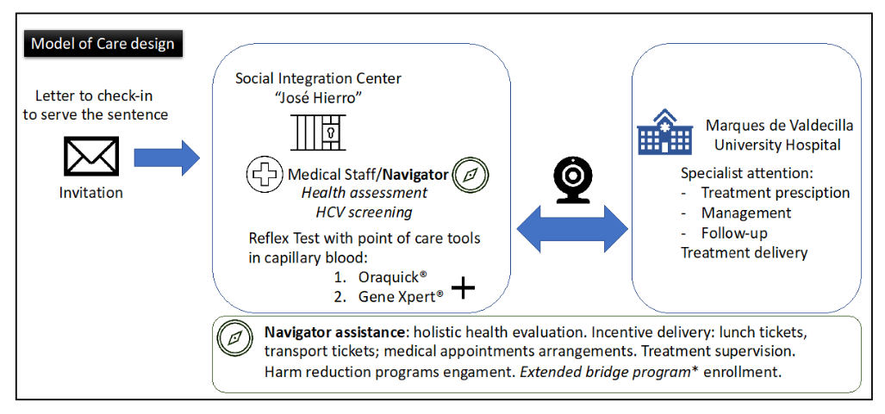
The HONEST project
Non-custodial sentences:
Cabezas J, et al. Diagnostics (Basel). 2021;11(5). doi: 10.3390/diagnostics11050877. PubMed PMID: 34068955; PMCID: PMC8155928.
Notes:
Cabezas J, Llerena S, Mateo M, Alvarez R, Cobo C, Gonzalez V, Martro E, Cuadrado A, Crespo J. Hepatitis C Micro-Elimination beyond Prison Walls: Navigator-Assisted Test-and-Treat Strategy for Subjects Serving Non-Custodial Sentences. Diagnostics (Basel). 2021;11(5). Epub 2021/06/03. doi: 10.3390/diagnostics11050877. PubMed PMID: 34068955; PMCID: PMC8155928.
Cabezas J, et al. Diagnostics (Basel). 2021;11(5). doi: 10.3390/diagnostics11050877. PubMed PMID: 34068955; PMCID: PMC8155928.

Slide 23
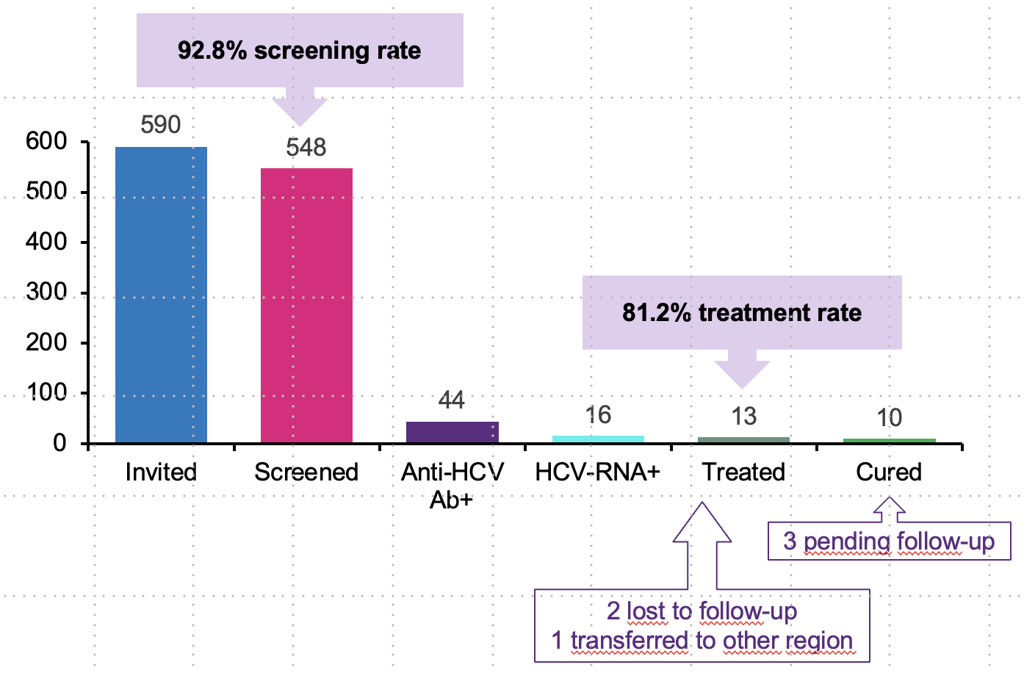
The HONEST project
HCV seroprevalence: 8%; RNA prevalence: 2.9%
Cabezas J, et al. Diagnostics (Basel). 2021;11(5). doi: 10.3390/diagnostics11050877. PubMed PMID: 34068955; PMCID: PMC8155928.

Slide 24
Liaison nurses
N = 2358.
- 5.4% - hospital attention
- 6,2% - addiction attention
70% accomplised visits
Incarceration
Release
Turu E et al. Rev Esp Sanid Penit. 2019;21(3):163-170
Notes:
2.358 pacientes estudiados. Se precisó una atención hospitalaria postexcarcelación en 128 casos (el 5,4%) y atención en drogodependencias postexcarcelación en 146 (6,2%). Aproximadamente el 60% de la visitas necesarias se programó en el plazo de tiempo previsto y el 70% se efectuó de forma adecuada.
Rev Esp Sanid Penit. 2019;21(3):163-170

Slide 25
Data on elimination in prison?
http://www.institucionpenitenciaria.es/web/portal/centrosPenitenciarios
Cabezas J, et al. EASL-DILC 2020; J Hepatology. 2020;73:S33;

Slide 26

It is not all done

Slide 27
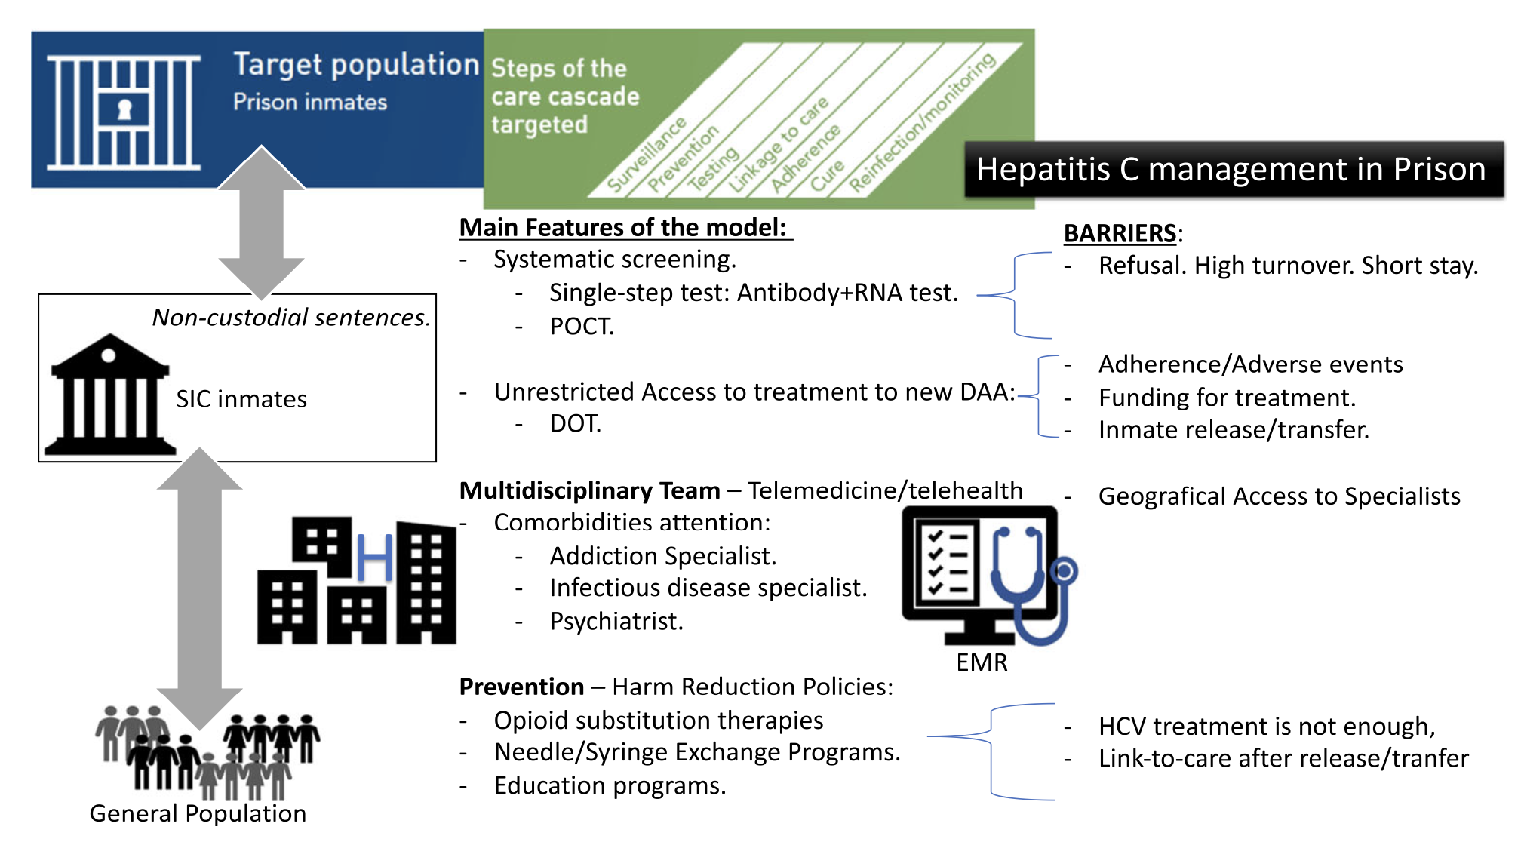
Designing a good model of care for Hepatitis C in prison
SIC=Social Insertion Center (similar to correctional setting); DOT: direct-observed therapy; POCT: point-of-care tests
Crespo J, et al. Current Hepatology Reports. 2019;18(2):259-67.
Notes:
respo J, Llerena S, Cobo C, Cabezas J, Cuadrado A. HCV Management in the Incarcerated Population: How Do We Deliver on This Important Front? Current Hepatology Reports. 2019;18(2):259-67.
Crespo J, et al. Current Hepatology Reports. 2019;18(2):259-67.

Slide 28
Designing a good model of care for Hepatitis C in prison
Prevention
Opioid Substitution Therapy
Needle-Syringe Programs
Overdose Prevention/Reversal
HIV and HCV Testing and Treatment
Harm reduction goals:
  Decrease medical, social, economic harms resulting from drug use.
Harm reduction outcomes:
  Reduces HIV, HCV transmission.
  Prevents overdose death.
  Improves health, social service uptake.
Transition to the community:
Education,
Case management and discharge planning,
Hepatology in-reach nurses,
Transition clinics,
Primary care providers and system wide
Sander. J Correct Health Care. 2019;25:105. Kamarulzaman. Lancet. 2016; 388:1115. Hedrich. Addiction. 2012;107:501.
McKeever A, et al. Journal of viral hepatitis. 2023;30(4):278-82
Notes:
McKeever A, O'Donovan D, Kee F. Factors influencing compliance with Hepatitis C treatment in patients transitioning from prison to community-A summary scoping review. Journal of viral hepatitis. 2023;30(4):278-82.
McKeever A, et al. Journal of viral hepatitis. 2023;30(4):278-82.

Slide 29
Conclussions
Manage Hepatitis C in prison is posible
It is a priority;
Models of care can be adapted to your own features.
Include prevention programs,
  Improve linkage-to-care continuum after release
Hepatitis C Elimination in prison can be a reality.

Slide 30




Thank you!
joaquin.cabezas@scsalud.es
@ JCabezasGlez
El Dueso Prison. Cantabria. Spain

